Slide 1
Agile Task Manager: How-To Guide

Slide 2
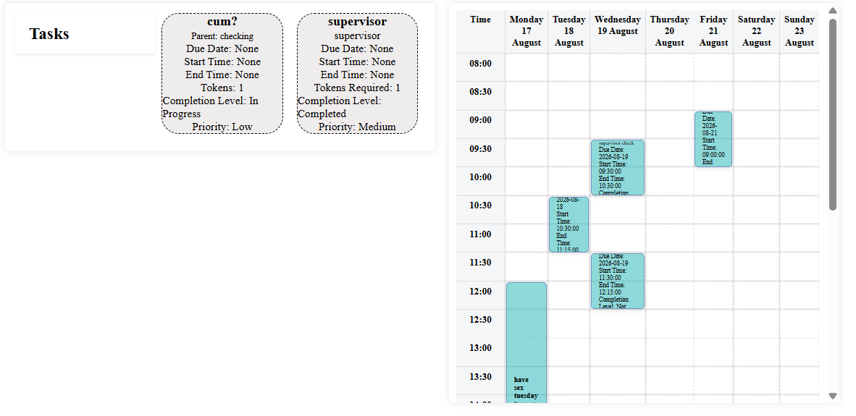
Sprint: Timetabling
Layout:
Tasks Box: Contains all tasks with unassigned start/end times and due date
Timetable: all assigned tasks for this week are visible here. Tasks and subtasks are overlayed on the timetable to give an accurate view of task duration (this is based off token number and duration value assigned in settings)
How to Use:
Sub/Tasks start in the tasks box once added
Sub/Tasks can be dragged onto the timetable where they are assigned a new due date, start and end time according to where they are dropped
Within the timetable the tasks can also be dragged between the dates

Slide 3
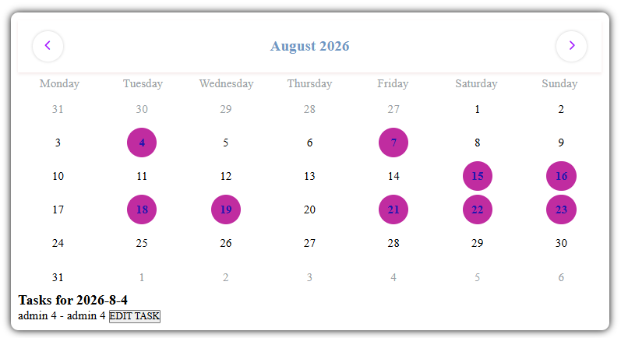
Calendar
Layout:
Calendar:
Viewed as months
Dates lit up purple are dates containing assigned tasks
For dates with tasks, there is an “EDIT TASK” button
How To Use:
Toggle through the months using the arrows on either side of the month and year
Click on the purple dates to view and edit tasks using the “EDIT TASK” button

Slide 4
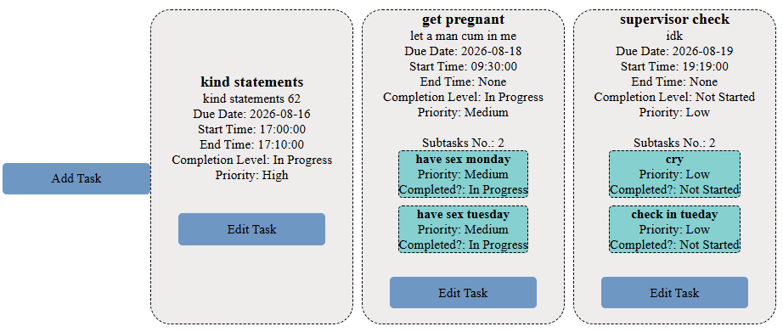
Backlog
Layout:
Tasks in grey
Subtasks in pale blue
Edit Task button for each sub/task
Add Task Button
How to Use
Click on the Add Task button to add a new task to backlog. All fields are mandatory to ensure you do not procrastinate assigning them
Tasks are only visible if they have not been completed
All tasks can be edited using the Edit Task button inside the grey box. Tasks with subtasks will have the subtasks sitting under the main task in pale blue and can be edited the same way

Slide 5
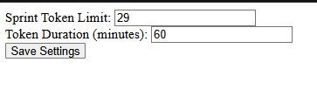
Settings
Layout:
Sprint Token Limit
Token Duration
How To Use:
Assign values to Sprint Token Limit and Token Duration. This limits the number of tasks than can be tackled during each sprint (set as one week).
Each task and subtask is auto set to one token unless changed upon creation or editing.
The token duration is the amount of time expected for the task to take if it was only worth one token (a measure for effort required). Please set token limit and token duration sensibly to ensure sprint weeks and tasks assigned are not overwhelming. Adjust as needed.

